Slide 1
Project Management Methodology
Quality Control Diagrams
Seven basic tools of quality

Slide 2
Quality control tools
Special tools used to monitor project parameters to ensure that they are compliant with the relevant quality standards
  Quality metrics and diagrams (Pareto charts, Fish bones, others)

Slide 3
Fishbone diagram
Used to discover and enumerate the factors that can impact the product quality
Is in fact the tree to show first biggest factors (skeleton) with the branches showing decompositions
Used for analysis purposes

Slide 4
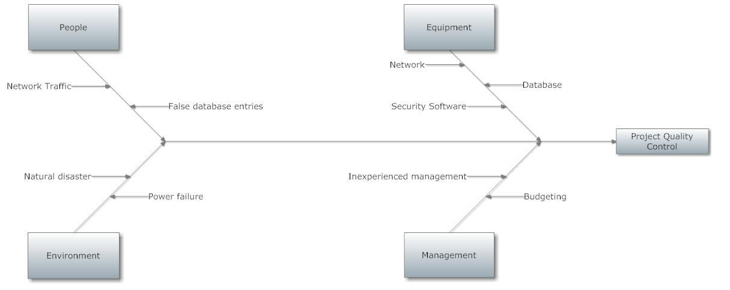
Fishbone sample

Slide 5
Control Chart
Used to control processes
It is built to verify whether we have enumerated ALL the factors that impact the process
If yes, we can rely on available methods of evaluation and can use them to predict the future
If not, we should perform additional analysis to discover invisible factors

Slide 6
Control Chart
Measurements
  The process quality characteristics measurements upon the timeline
Calculated
  Center line (e.g. average per hour)
  Standard errors (deviation that is considered standard
  Upper limit and lower limit, define the corridor where deviations are acceptable

Slide 7
Control Chart
If measured values are in the corridor the process is under control
If they are located beyond the corridor – some unknown factors exists that impact the process
It also means that current model is not reliable, improvements required

Slide 8
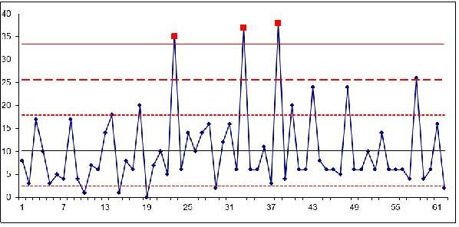
Control Chart sample

Slide 9
Comments
The process – vulnerability assessment
Measurement – number of false positive
Center line – average per period
Standard error – expected deviation
Upper limit (3 time more)
Lower limit (3 time less)
Result – some values are beyond the corridor, the process is not under control

Slide 10
Run Chart
Used to see the trend of changes in measurements for a given quality characteristic in a time sequence
Measurement
  The characteristic values in a time sequence

Slide 11
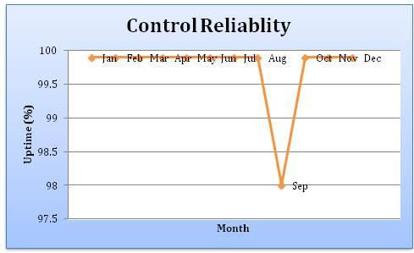
Run Chart sample

Slide 12
Scatter diagram
Used to analyze correlations that exists between two factors
Factors can be any, not necessarily time
Measurements:
The pairs of values for the characteristics measured in a time sequence

Slide 13
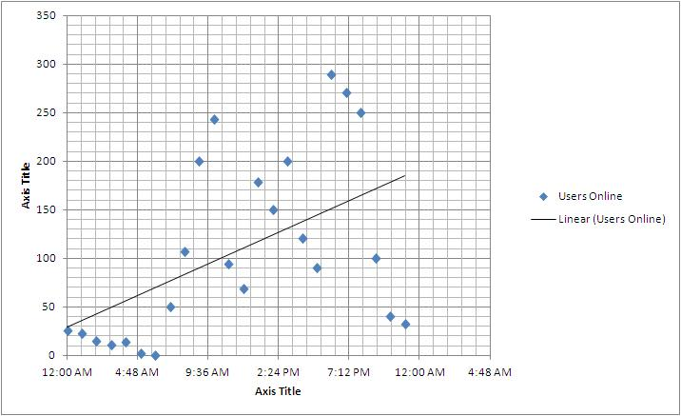
Scatter Diagram sample – Orange team (Shayne, Todd, Yash, Tim)

Slide 14
Histogram
Used to plot density of data
Measurement
  Values in pairs to show how many occurrences of A pertain to a given value of B
  A and B can be anything, not necessarily time

Slide 15
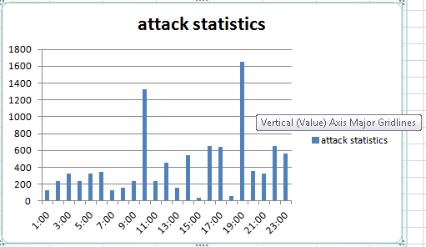
Histogram sample

Slide 16
Pareto charts
Used to identify and prioritize problem areas (aka 80/20 rule)
Read “80% of problems are caused by 20% of reasons”
The diagram collect stats of a problem occurrences
Use Bar Charts to indicate most common quality problem causes—address these first (taking severity into account of course)

Slide 17
Pareto Chart
Measurements
  Number of occurrences by identified problems within a given period of time
Calculation
  Total (cumulative) number of occurrences
  Percent of occurrences of each factor rated against total number of occurrences
Histograms must placed in the descending order

Slide 18
Pareto Chart
Drawing
  Horizontal axe – problems
  Left vertical axe – frequency of occurrence
  Right vertical axe – cumulative percent of occurrences
Reading
  Draw a line at 80% on y-axis parallel to x-axis. Then drop the line at the point of intersection with the curve on x-axis. This point on the x-axis separates the important causes on the right and less important causes on the left.
Result
  Problems to the right from the vertical line are most important

Slide 19
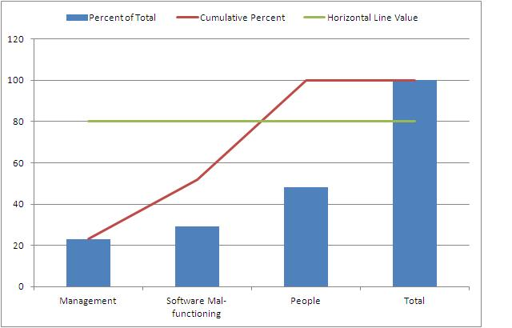
Pareto Chart sample

Slide 20
Flow chart
Used to study the process, step-by-step
Decision blocks must be included
Parallel activities must be shown

Slide 21
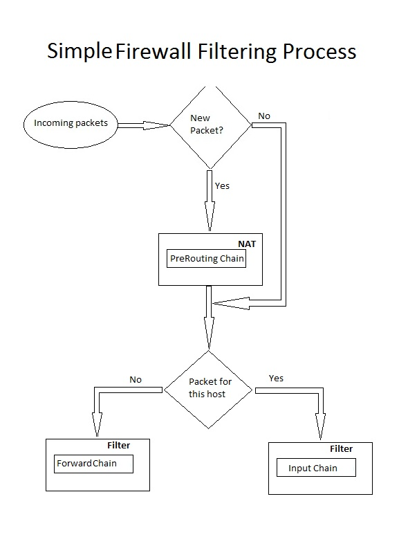
Flow chart sample

